Slide 1
FOOD ORDERING ONLINE SYSTEM

Slide 2
Abstract
ONLINE FOOD DELIVERY SYSTEM is a website designed primarily for use in the food delivery industry. This system will allow hotels and restaurants to increase scope of business by reducing the labor cost involved. The system also allows to quickly and easily manage an online menu which customers can browse and use to place orders with just few clicks. Restaurant employees then use these orders through an easy to navigate graphical interface for efficient processing.

Slide 3
Introduction
Online ordering system that I am proposing here, greatly simplifies the ordering process for both the customer and the restaurant. System presents an interactive and up-to-date menu with all available options in an easy to use manner. Customer can choose one or more items to place an order which will land in the Cart. Customer can view all the order details in the cart before checking out. At the end, customer gets order confirmation details. Once the order is placed it is entered in the database and retrieved in pretty much real time. This allows Restaurant Employees to quickly go through the orders as they are received and process all orders efficiently and effectively with minimal delays and confusion

Slide 4
Objective
Develop a system that will allow customers to place their food order online and provide them with feedback as to the calorie and fat count of the meal, a generic image of the meal, a list of side dishes, main course ingredients, and cost information.

Slide 5
What To Do?
provide a display that will allow the customer to choose menu items and make corrections.
update this display with changes to the order.
provide a running total cost and calorie/fat count.
At order finalization, we will request identification information from the customer.
offer a static map of our surrounding area so that customers unfamiliar with our location can find us.

Slide 6
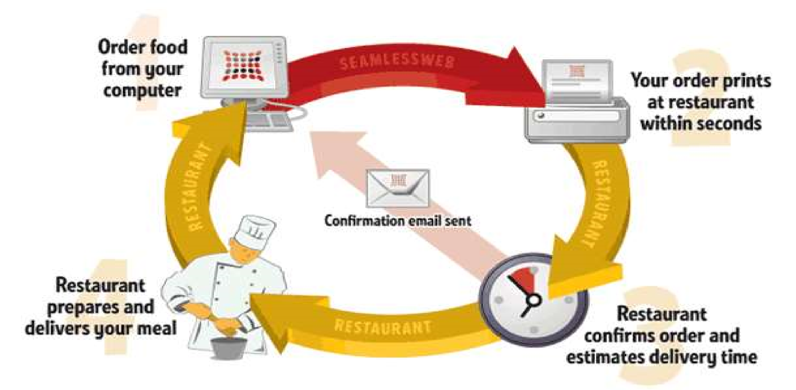
HOW AN ONLINE FOOD ORDERING SYSTEM WORKS

Slide 7
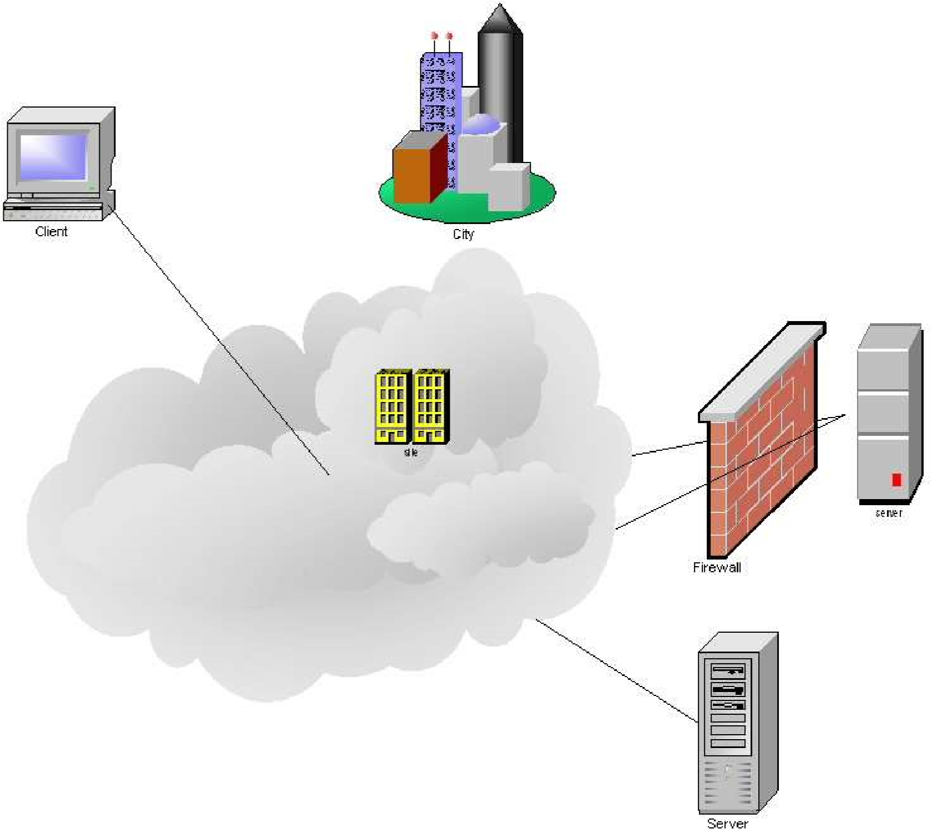
What We Will Do?

Slide 8
Implementation
Hardware Interface:
Pentium Processor
60 MB of free hard-drive space
128 MB of RAM
Software Interface:
Operating System: Windows (7 or 10)
ASP.net tool
Languages used: c#,html,css
Tomcat platform
Database used: mySQL

Slide 9
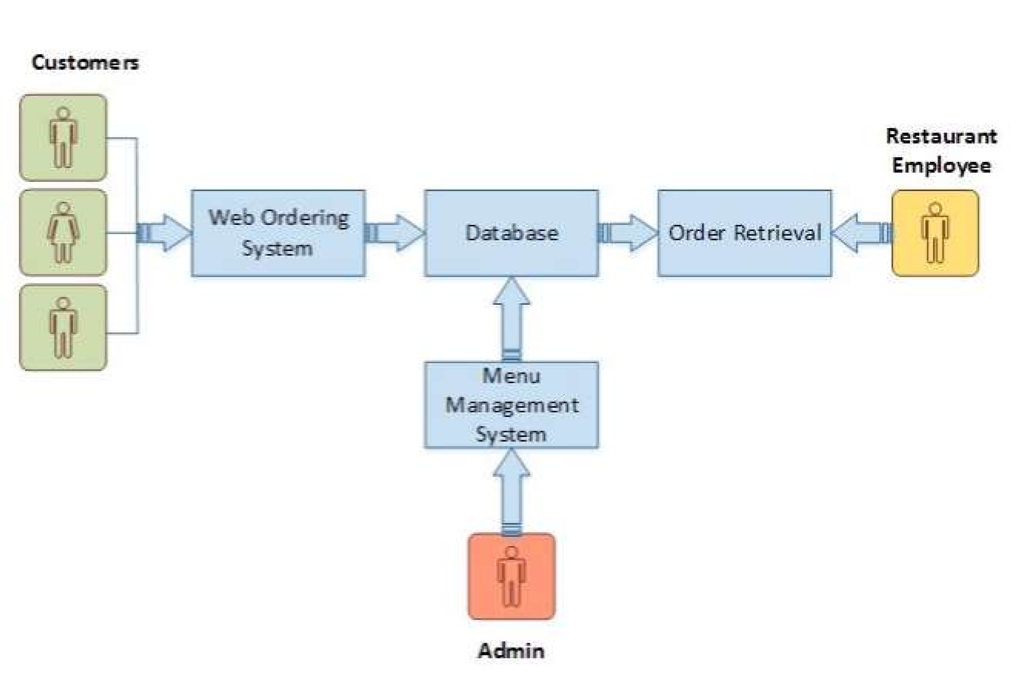
Program Requirements

Slide 10
Future Work
The following section describes the work that will be implemented with future releases of the software.
Customize orders: Allow customers to customize food orders
Enhance User Interface by adding more user interactive features. Provide Deals and promotional Offer details to home page. Provide Recipes of the Week/Day to Home Page
Payment Options: Add different payment options such as PayPal, Cash, Gift Cards etc. Allow to save payment details for future use.
Delivery Options: Add delivery option
Order Process Estimate: Provide customer a visual graphical order status bar
Order Status: Show only Active orders to Restaurant Employees.
Order Ready notification: Send an Order Ready notification to the customer

